Slide 1

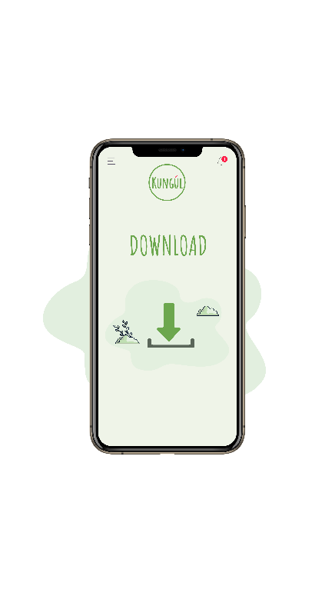
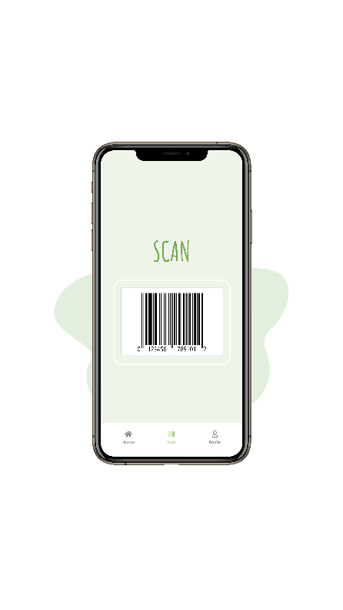
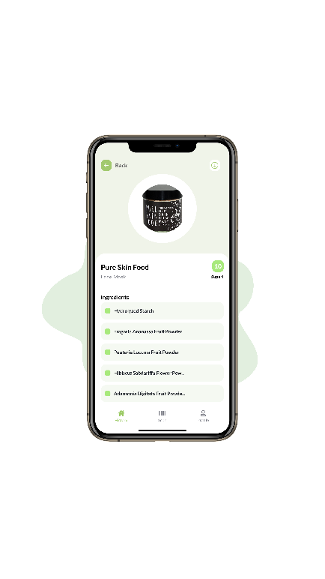
Can Kungul Revolutionize Skincare Safety?
Analyzing Ingredient Transparency &
Empowering Consumer Choices

Slide 2

Project Overview
1
TEAM MEMBERS
NIKOLA MILEV
MANUELA FILIPOVSKA
EMILIJA TRAJKOVSKA
STEFAN TRAJKOVSKI
-Summary-
Our goal is to assist Kungul with their mobile application that assesses the safety of products based on their ingredients. We were tasked with cleaning and enriching the provided data and building an Optical Character Recognition (OCR) model for ingredient extraction from a specific product which we later match with the existing data in their database were they have information related to the safety of each specific ingredient.
IMPROVEMENTS
The app now offers a more comprehensive and accurate scanning system, enabling users to identify harmful ingredients in their skincare products.
ACHIEVEMENTS
After extensive work on the Kungul project, significant improvements have been implemented.
GOALS
Empower consumers to make healthier decisions regarding their self-care products.

Slide 3
Project Flow
2
- Data-Ingredients -
Step 1
Data Cleaning
14.728 rows
5.267 cascodes
6191 cascodes 36.714 substitute names
Step 2
Data enrichment
Step 3
Barcode scanner
and Ingredient extractor
OCR Model Development
Step 4
Successfully matching extracted data with database
Ingredients Matching and Information Retrieval

Slide 4
Step 1-Data Cleaning
3
We began by cleaning the provided data, which consisted of two Excel files:
1. Products file: which contains product information and barcodes, and
2. Ingredients file: with details related to the possible harmful effects of the ingredients.
Our initial focus was on cleaning the ingredients data.
Rows with multiple ingredients were split and placed in a new row, and we carefully extracted CAS numbers from the CASCODE column while eliminating irrelevant information.
This step was pivotal in preparing a standardized dataset for analysis.

Slide 5
Step 2-Data Enrichment
4
OVERVIEW
SOURCE
STATISTICS
To fortify our ingredient database, we engaged in proactive data enrichment strategies.
Leveraging web scraping techniques on the common chemistry official website we succeeded in enriching our dataset with new CAS codes and substitute names for ingredients.
We identified 924 new CAS numbers based on ingredient names in the Name column and additionally, we collected a total of 36.714 substitute names for 5654 ingredients based on the CAS number from the CASCODE column.
Results
By carefully cleansing our dataset and using web scraping techniques, we achieved a substantial improvement in both coverage and accuracy.
Future enhancements
Continued efforts in data cleaning will fortify the dataset's integrity, ensuring higher accuracy and reliability.
Additionally, exploring the extension of web scraping methodologies across diverse websites can yield a more comprehensive and efficient dataset.

Slide 6
Step 3-OCR Model Development
5
Central to our project was the development of an OCR model
Firstly
The OCR model will try to extract barcodes from product images, match them in the barcode dataset, and extract all the ingredients related to the specific product.
Secondly
When barcodes are unavailable or unidentifiable the OCR model will directly export the ingredients from the text on the picture.
RESULTS:
This innovation enabled us to collect a comprehensive list of ingredients for analysis.
Recommendation for Future Enhancement:
Given the significantly higher accuracy and 100% certainty in ingredient extraction achieved by leveraging the barcode scanner technology, a strategic step for future enhancement would be to consider enriching the existing barcode database.

Slide 7
Step 4-Ingredients Matching and Information Retrieval
6
MATCHING
Using the OCR-extracted ingredient list, we engaged in a matching process against our enriched dataset. This step allowed us to provide vital information about each ingredient, indicating its status as an allergen, carcinogen, endocrine disruptor, or skin irritant.
Accessing status as a allergen, carcinogen, endocrine disruptor, or skin irritant
OCR extracted ingredient list
Matching with Ingredients in dataset
Accurate information about product safety
RESULT: This seamless matching process ensured accurate safety assessments for products.

Slide 8
CONCLUSIONS
7
Our project has laid a strong foundation for better product assessment and analysis.
By carefully cleaning, enriching, and employing OCR technology, we were able to extract ingredients from a specific product and match it to our enriched database.
1st
Cleaner dataset
2nd
Enriched dataset
3rd
Successful ingredient extraction from picture
4th
Efficient matching with dataset
5th
Added value to the final user by receiving accurate and useful information about product safety

